Slide 1

Transceiver Sensitivity (Wireless)
Ramson Munyaradzi Nyamukondiwa
Edgar Mujuni
31 August 2021

Slide 2
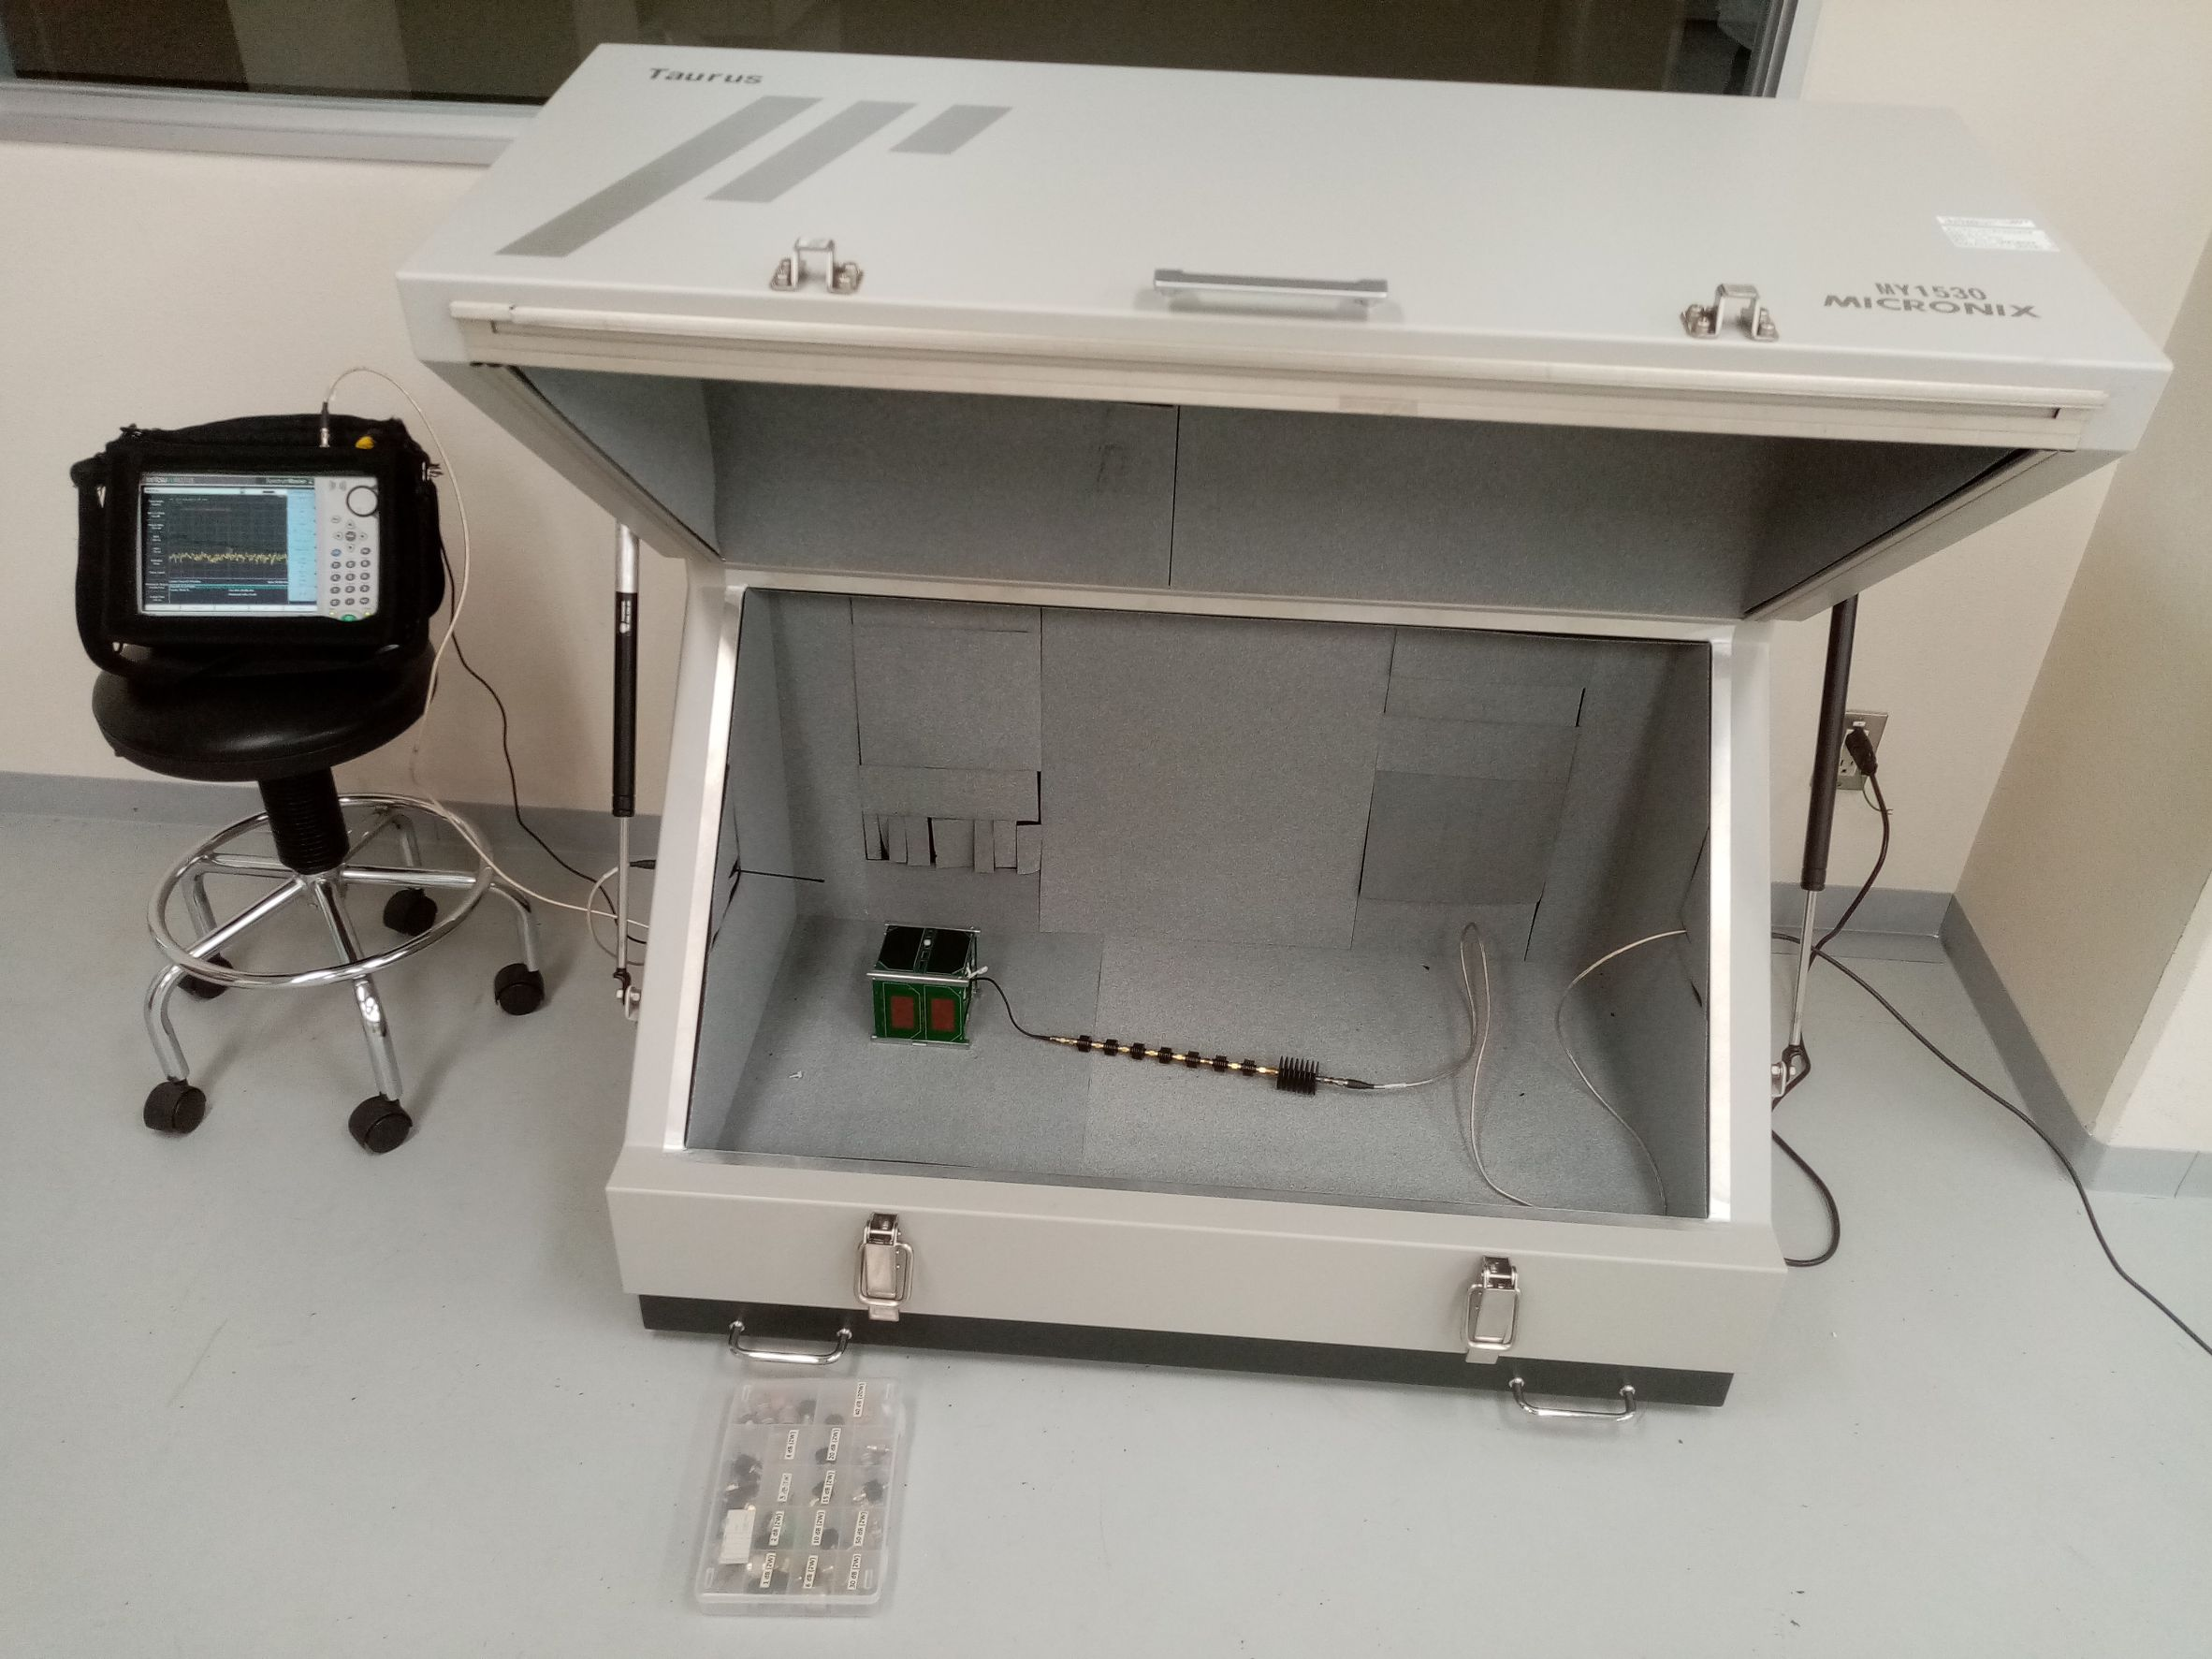
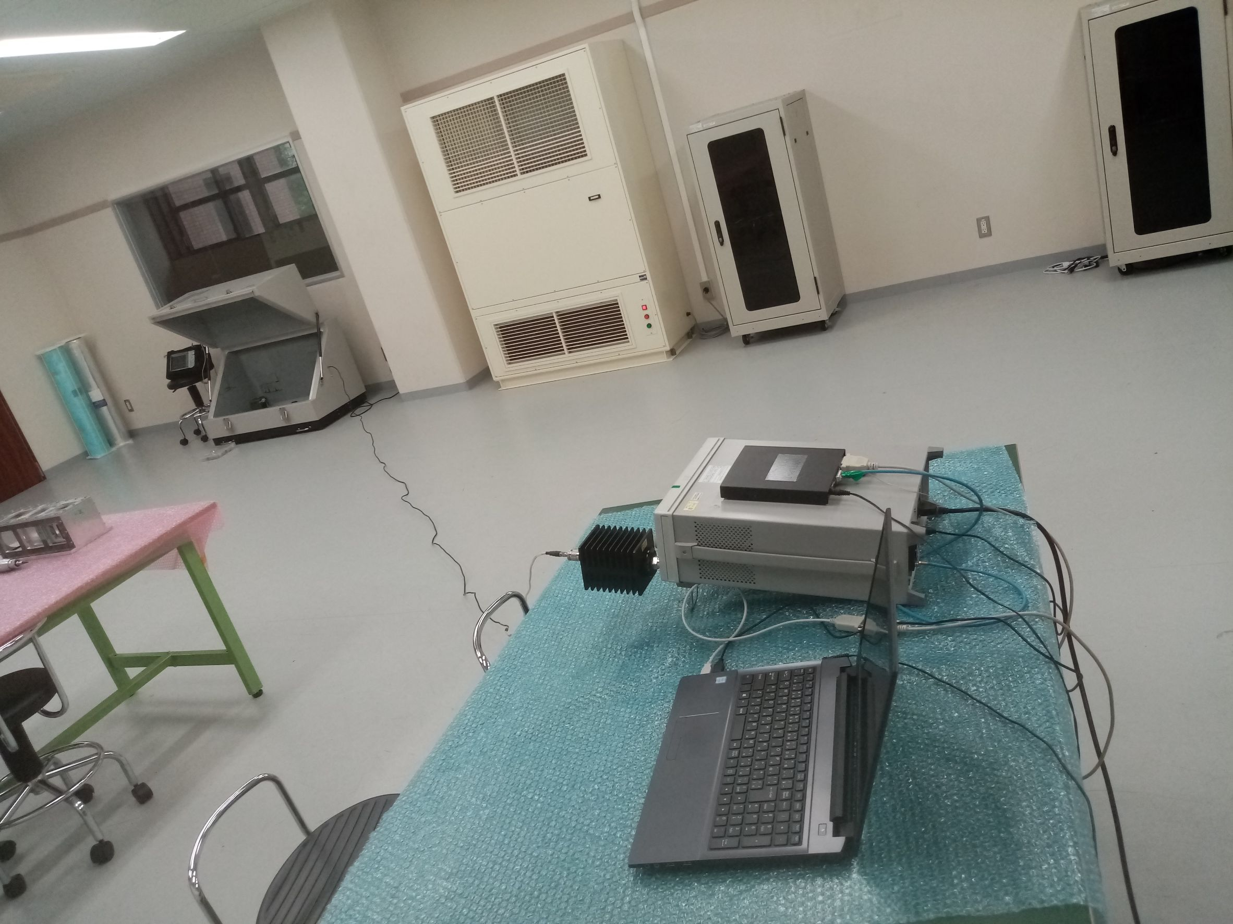
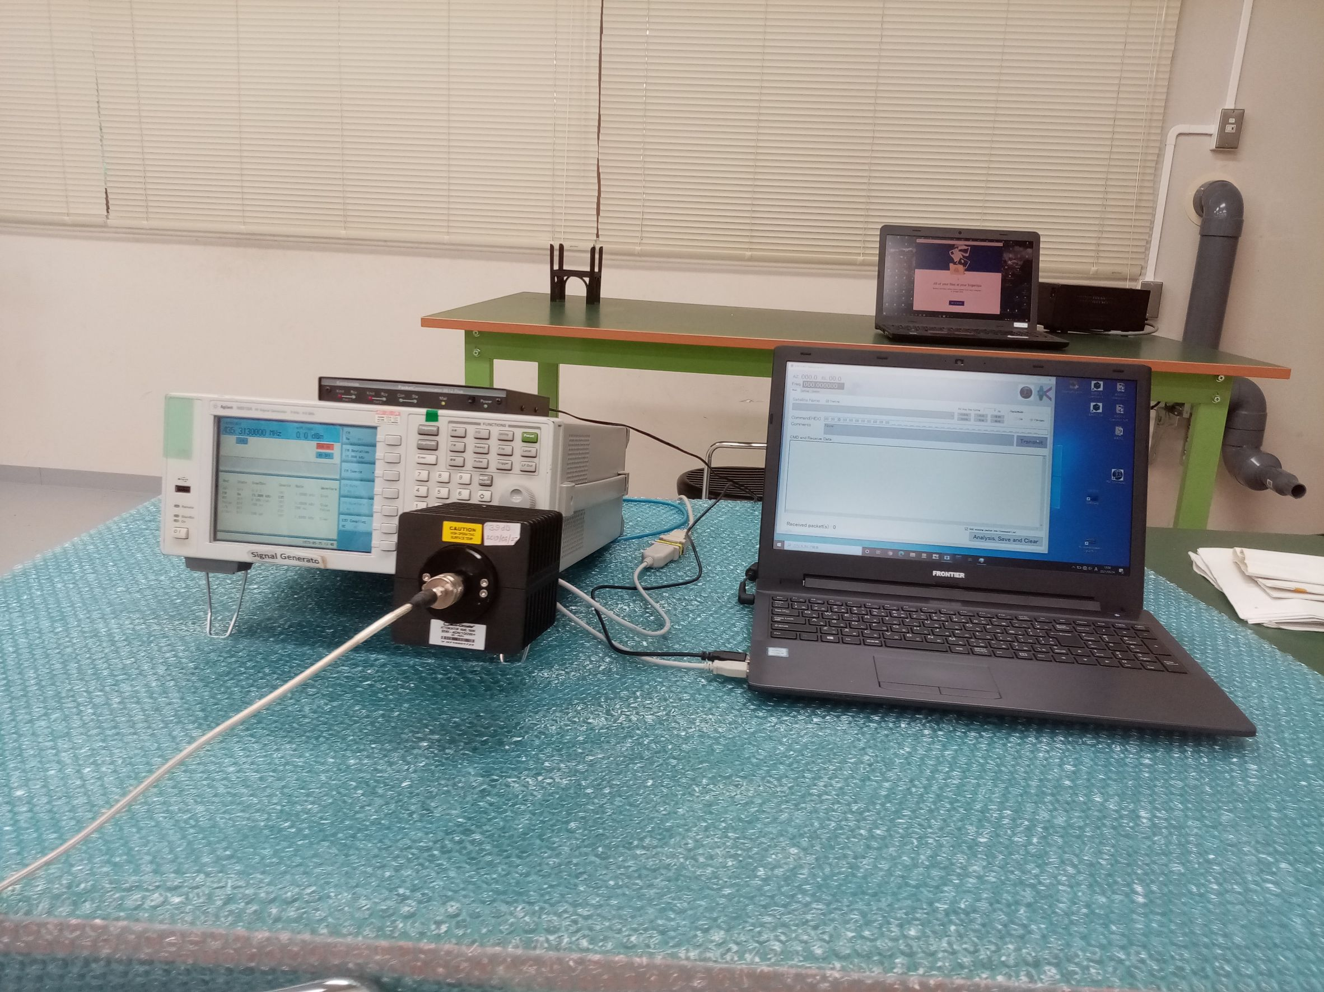
Signal Generator Setup
Shield Box Settings
Overall Settings
Spectrum Analyser
Attenuators
Satellite
GS setting
TNC
SG
GS laptop
39dB Attenuator

Slide 3
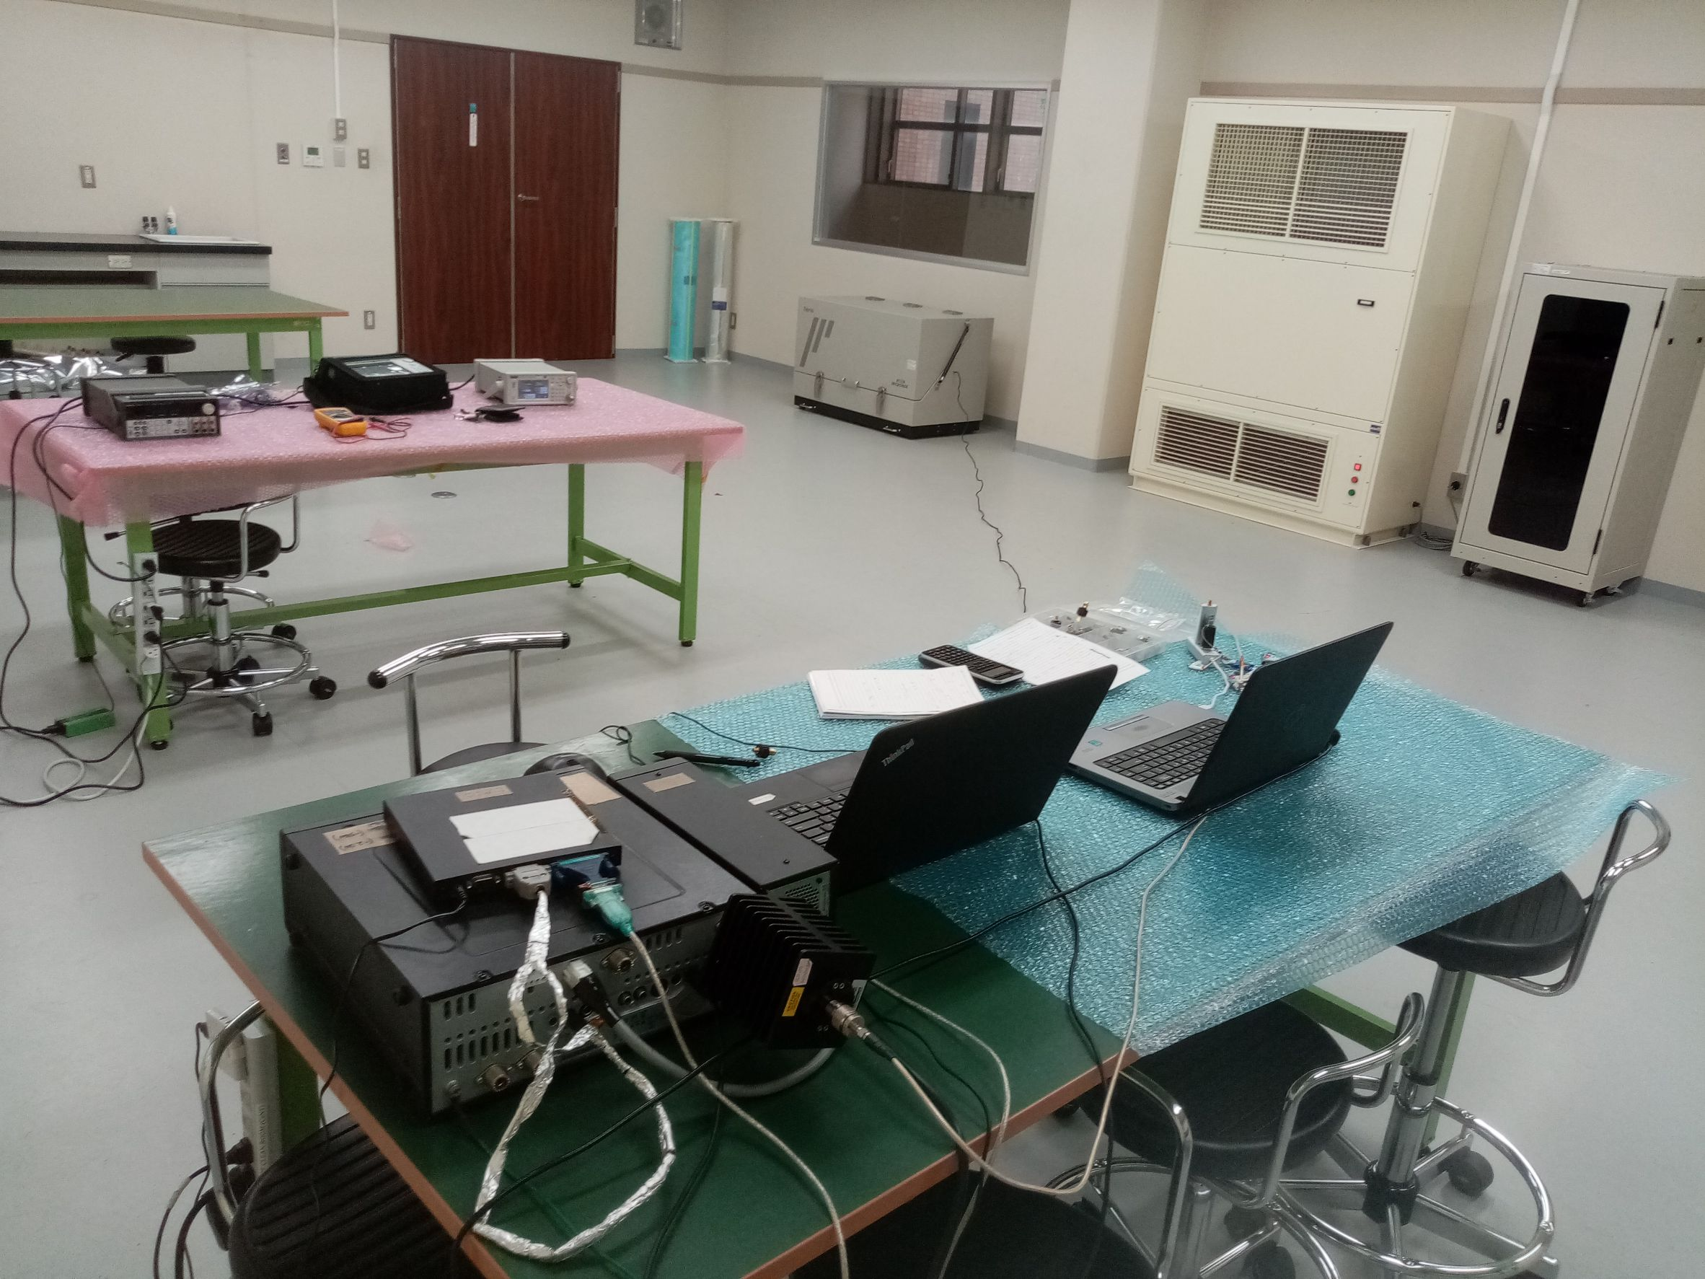
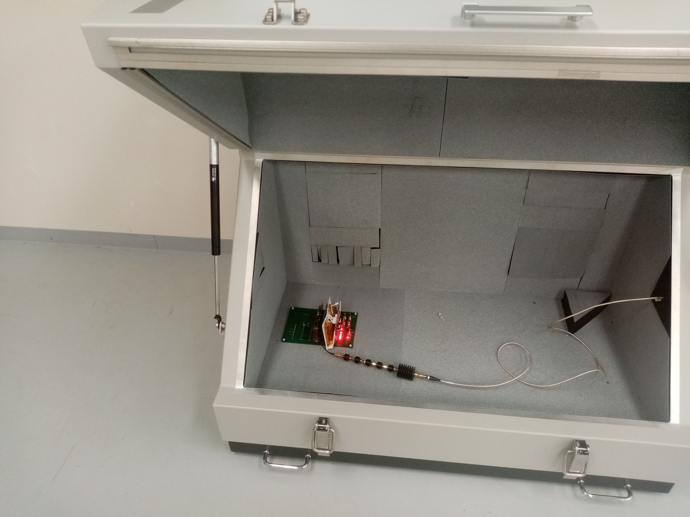
Radio SetUp
Inside the Shield Boxc
Shielded Box
Cable: Cable loss: 3.2 dBm
GS
Attenuator > 100 dB
Attenuator: 39dB
Componets
Attenuators
FAB
Battery
OBC
Comm TRX
BPB
NB: Using radio setup gives little lower sensitivity (-110.1 dBm) because radio output spectrum is little different from SG setup

Slide 4
Comparison of BIRDS Cable Test Results
BIRDS Satellite | RSSI (dBm)
BIRDS-2S | -114
BIRDS-3 | -114
BIRDS-4 | -114
BIRDS-5 (TRX1 and TRX2) | -114
Conclusion:
BIRDS 2S, BIRDS 3, BIRDS 4 and BIRDS 5 same RSSI

Slide 5
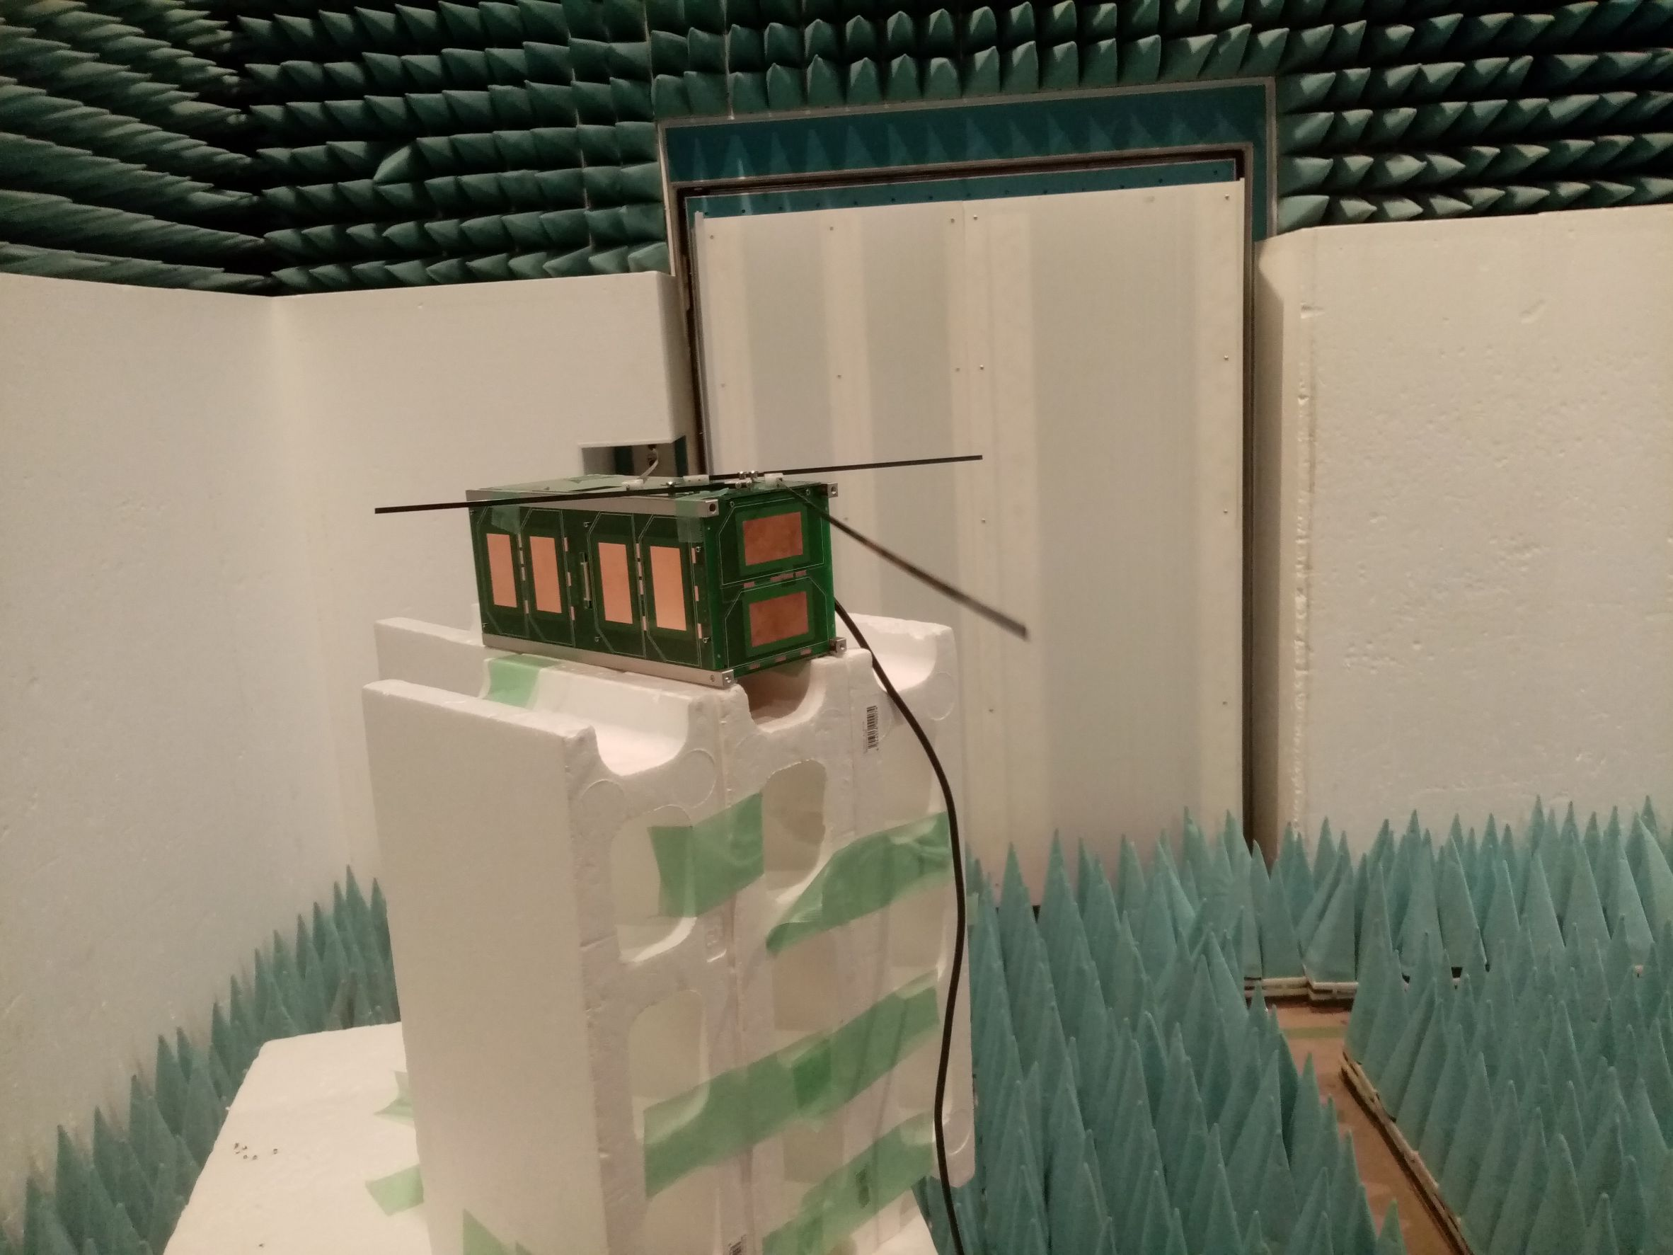
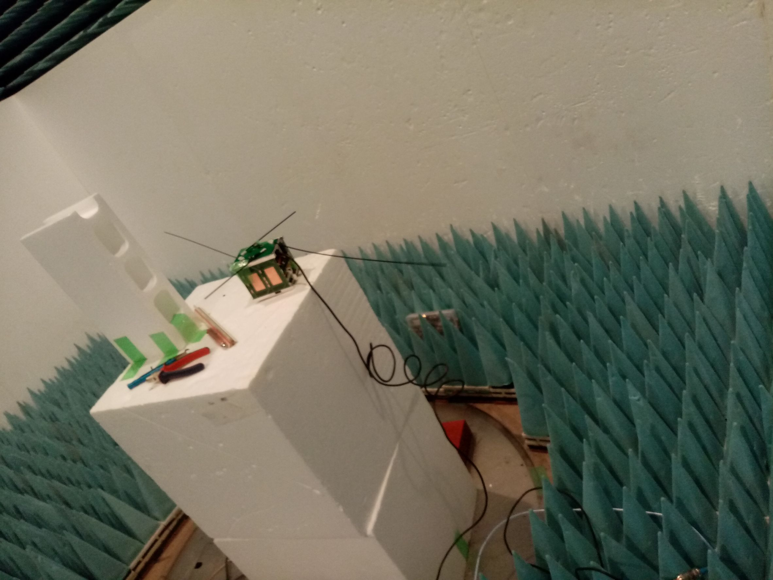
Anechoic Chamber
2 U Satellite
1U Satellite
Test Plan
Test : Measuring TRX Sensitivity with Dipole Antenna (LUPV and PUPV)for 14Byte CMD
Calibration
Measure cable loses
Measuring the ICOM radio transmission power
Determine the path loss for Up and Downlink
Theoretical and Practical
Determine the gains with respect to the
Reference antenna, and Birds 5 antenna.
Measure received and transmitted signal power at the antenna
Uplink success rate

Slide 6

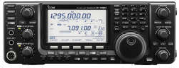
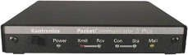
Test Setup
Reference antenna
GS
Door-2
Satellite
S.A
UHF Antenna
Anechoic chamber
Door-1
Door-3
47dBm
UHF Dipole antenna
ICOM-9100 Radio
Variable Attenuator
39dBm
Satellite
TNC
S.A
UHF Antenna

Slide 7
Anechoic Chamber Test Result Comparisons
BIRDS | Sensitivity (dBm)
BIRDS-3 | -102.8 SG, -98 Radio Setup
BIRDS-4 | -94 (shielded), -90 (Unshielded) => Ungrounded STR -101 (shielded), -92 (Unshielded) => Grounded STR
BIRDS-5 | 1U: -104.25 2U: -103.4 without PINO, -101 with PINO
14 Byte Command at 60% success Rate
Analysis:
BIRDS 5 show similar performance to BIRDS 3 and BIRDS 4 with GRND STR.

Slide 8
Mock Long Range Test: Shield Box
Other Side: at Long Dist
Shield Box
GS Side
ACK
Uplink Command
Monp Ant
Commercial Dipole
EM Sat
Distance (0.9 m)
GS Side: SG/ Radio
Variable Attenuation
SA
Foam
Test – 1 : Calibration
Measuring downlink effective attenuation
Checking polarity of BIRDS GS antenna (commercial dipole antenna)
Measuring uplink effective attenuation
Test – 2 : Measuring UHF TRX receiving sensitivity of BIRDS5 EM

Slide 9
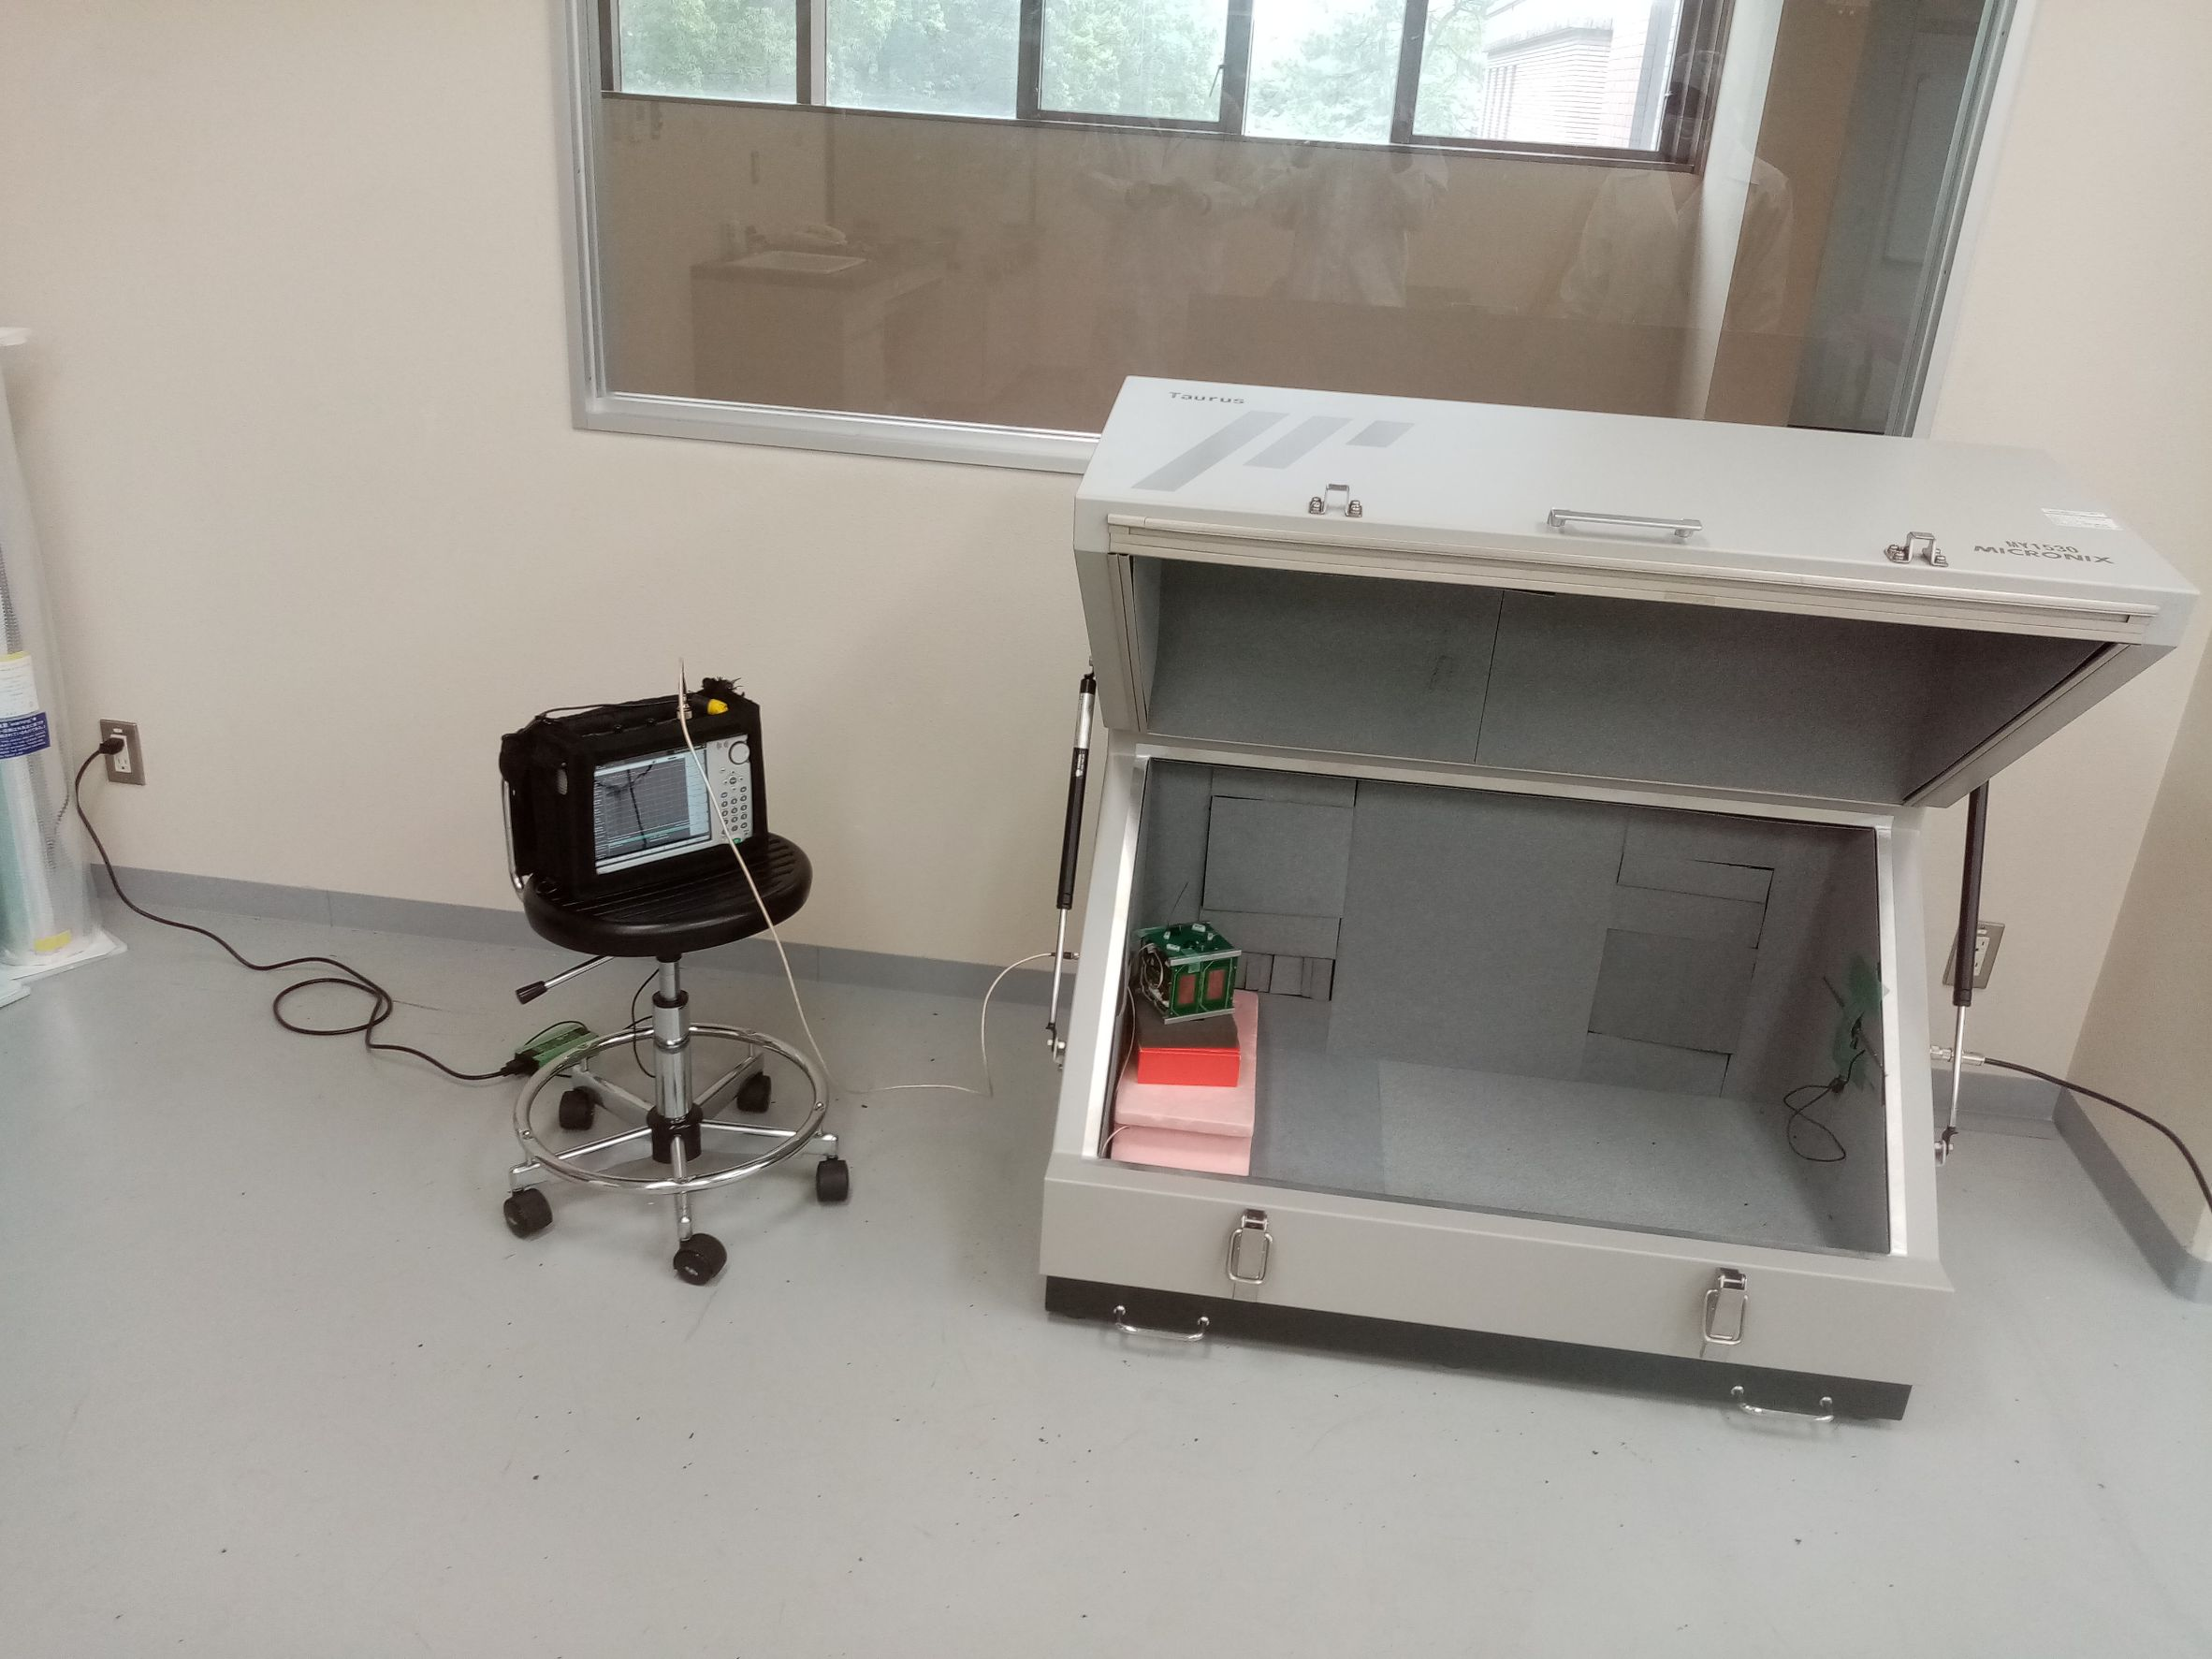
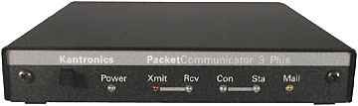
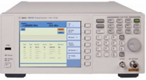
Actual Equipment Setting
BIRDS GS PC
Shield Box Setup
Signal Generator + TNC (SG)
SA
Com. Dip. Ant
EM SAT
Variable
Attenuator
Operation Side

Slide 10
Sensitivity Test Results
BIRDS | Sensitivity (dBm)
BIRDS-3 (Mt Sarakura) | -96
BIRDS-4 (Mt Sarakura) | -101
BIRDS-5 (In Shield Box) | -99

Slide 11
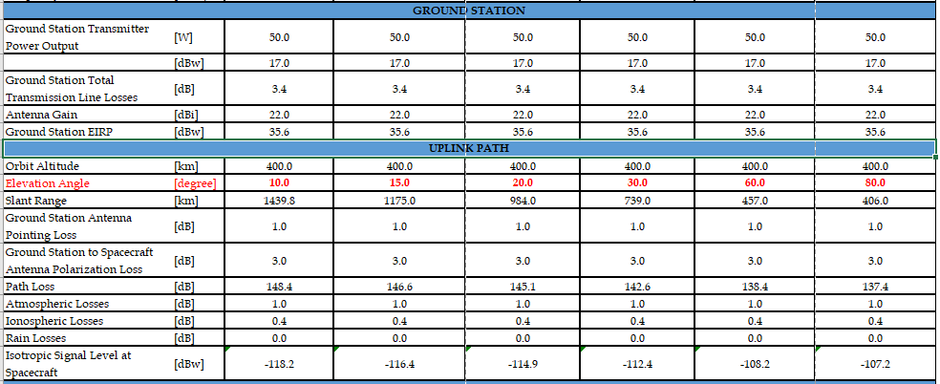
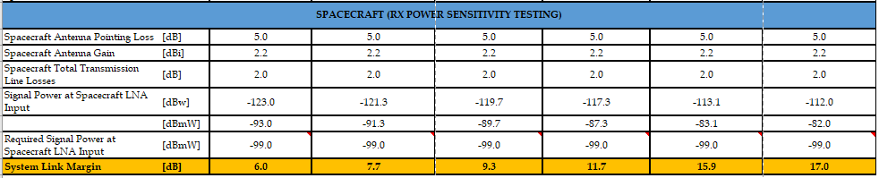
UHF UPLINK BUDGET

Slide 12
Link Budget Comparison
BIRDS Project | Link Margin
 | 10⁰ Elevation | 15⁰ Elevation | 20⁰ Elevation | 30⁰ Elevation | 60⁰ Elevation | 80⁰ Elevation
BIRDS-3* | 4.1 dB | 5.9 dB | 7.4 dB | 9.9 dB | 14 dB | 15.1 dB
BIRDS-4 | 8.8 dB | 10.5 dB | 12.1 dB | 14.5 dB | 18.7 dB | 19.8 dB
BIRDS-5 | 6.0dB | 7.7 dB | 9.3 dB | 11.7 dB | 15.9 dB | 17.0 dB
*BIRDS-3 link margin calculation was based on in-orbit data.
BIRDS-4 link margin is ~4 dB and 2 better than BIRDS-3 BIRDS-5 respectively.
BIRDS-5 is approx. 2dB better than BIRDS -3.

Slide 13
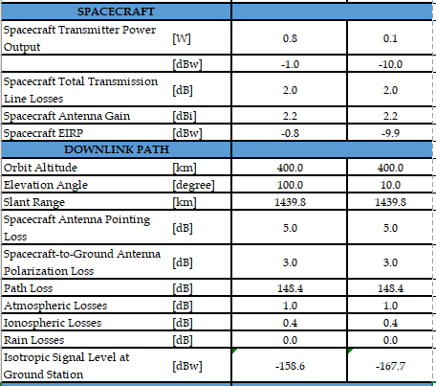
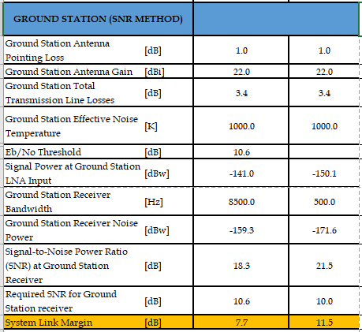
UHF DOWNLINK BUDGET

